Slide 1
Seven steps to remarkable customer service
An article by Joel Spolsky, presented by M. Ethan Reynolds

Slide 2
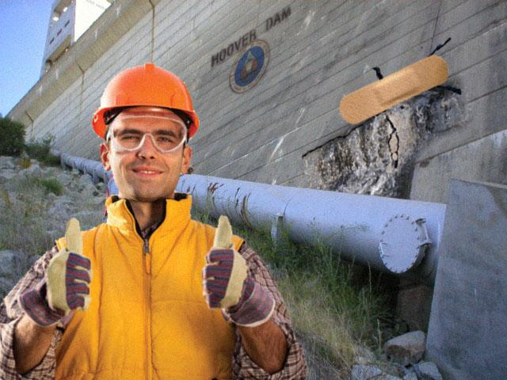
#1 Fix everything two ways
Superficial, immediate solutions fix a customers problems.
Deep solutions
prevent prevent that
particular problem
from ever happening
again.
Reduce time and
money spent fixing run-of-the-mill issues, focus on rare, complex problems.

Slide 3
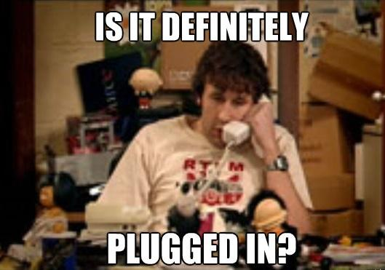
#2 Suggest blowing out the dust
Don’t ask the user
questions that should
be obvious.
Give the user a task
that forces them to
check things that
otherwise might be
embarrassing to have overlooked.

Slide 4
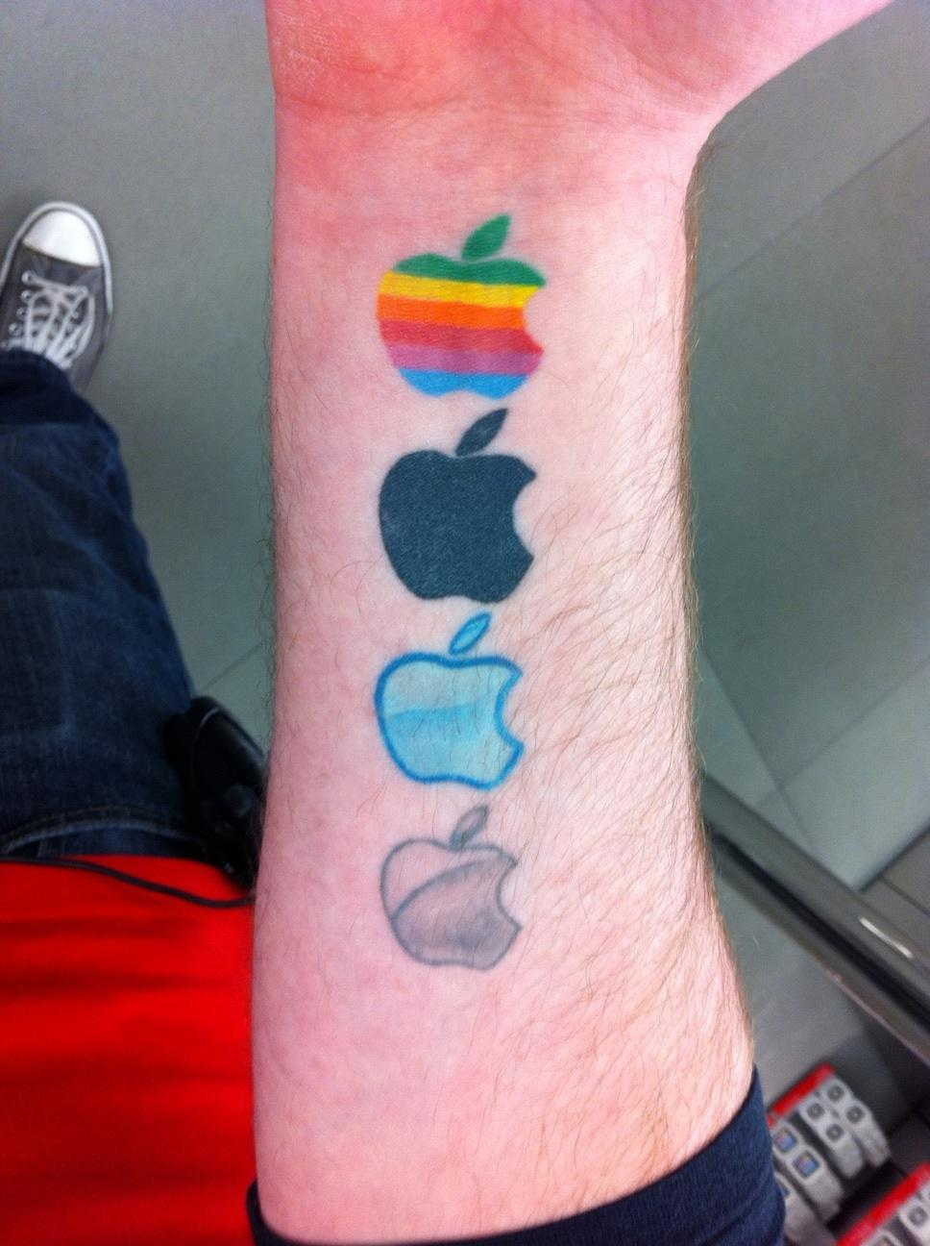
#3 Make Customers into fans
Go the extra mile to help the
customer.
When you fix a customers
problem, they will be more
satisfied that if they never
had a problem in the first
place.
When customers are
satisfied, they tell others why your organization is great.

Slide 5
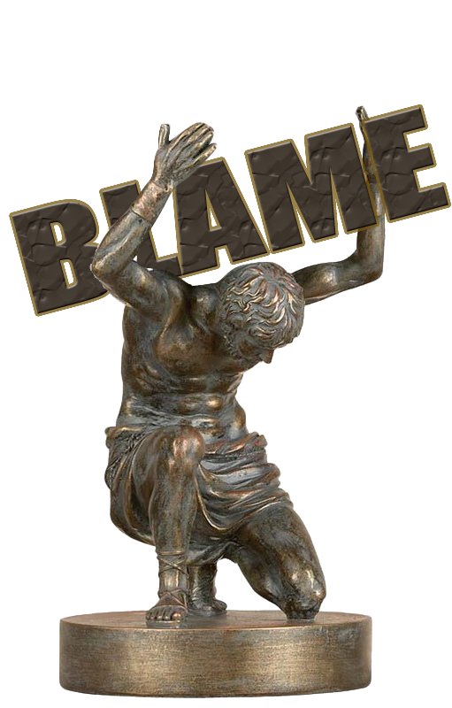
#4 Take the blame
Nothing diffuses an angry
customer like admitting
fault, and resolving to fix
the problem.
A disgruntled customer can
be just as negative as a
customer turned fan can be
positive.

Slide 6
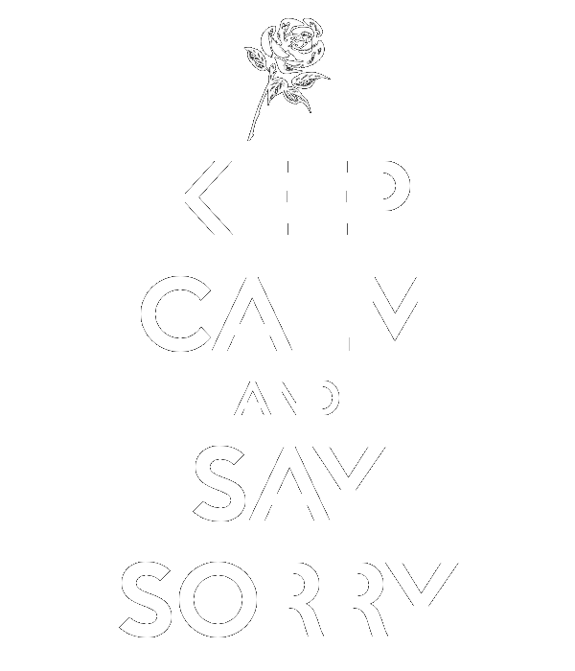
#5 Memorize awkward phrases
Practice saying the things
you don’t want to say.
“I’m sorry, it’s my fault.”
“I’m sorry, I can’t accept
your money. The meal’s
on me.”
Right or wrong, in many
cases keeping a customer
happy is more important than your personal victory.

Slide 7
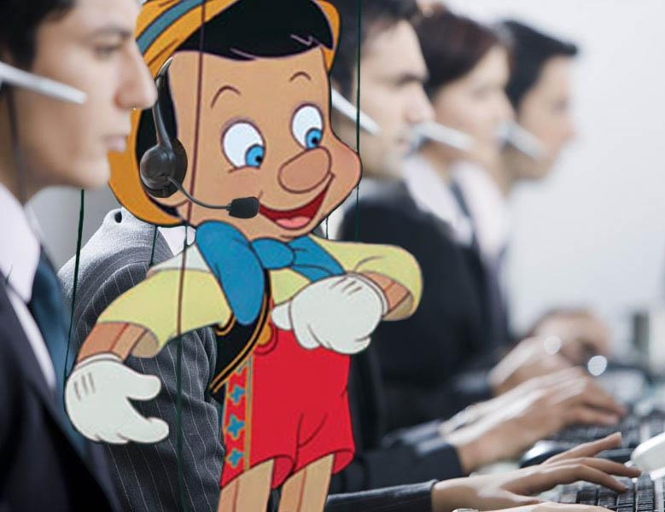
#6 Practice puppetry
Customer service
acts as a face of
an organization.
When an irate
customer is yelling
at you, they are
really yelling at
your company.
Be a puppeteer. Say what the customer needs to hear to help them.

Slide 8
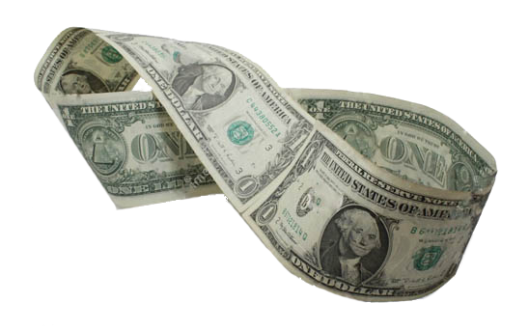
#7 Greed will get you nowhere
Be generous with things like return policies and return shipping.
Customers are
more likely to pull
the trigger on a
purchase if they know
a return will be easy.
This makes for happier and more numerous customers.

Slide 9
Questions?

